Slide 1

FindItBack – Lost & Found AI-Powered App
Welcome to FindItBack, an innovative AI-powered solution designed to revolutionize the lost and found process on college campuses. Developed by Our Team under the Open Innovation theme, FindItBack leverages cutting-edge image recognition technology to efficiently match lost items with their owners. This presentation will walk you through the problem we're addressing, our unique approach, the technology stack we've utilized, and the promising results we've achieved. Join us as we demonstrate how FindItBack can foster a more connected and responsible campus community, streamlining the recovery of lost items and enhancing the student experience.

Slide 2
The Problem: Lost Items on Campus
College campuses are bustling environments where students frequently misplace personal belongings. Traditional lost and found systems are often inefficient, leading to frustration and lost time for both students and staff.
Inefficient Matching
Manual Processes
Current methods lack the ability to quickly and accurately match found items with their owners. This results in items remaining unclaimed and students struggling to recover their lost belongings.
Existing systems often rely on manual processes that are time-consuming and prone to error. This can overwhelm campus staff and create a bottleneck in the lost and found process.
FindItBack addresses these challenges by providing an AI-powered solution that automates the matching process, enabling fast recovery and improving the overall user experience. Our solution aims to reduce stress and promote a more connected campus community.

Slide 3
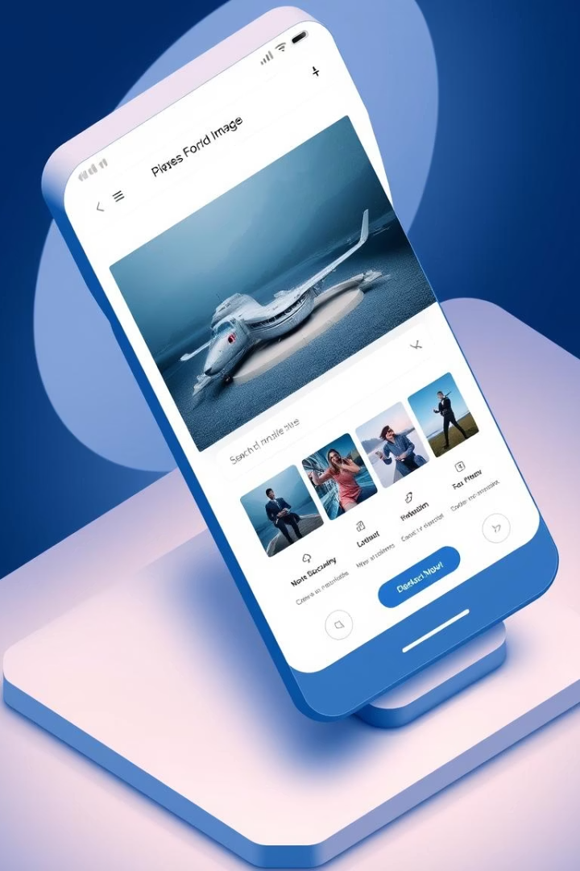



FindItBack: AI-Powered Solution
FindItBack is a user-friendly web application that leverages AI to simplify the lost and found process. By utilizing image recognition and machine learning algorithms, FindItBack automatically detects matches between lost and found items, streamlining the recovery process.
Easy Upload
Smart Matching
Users can easily upload photos and details of lost or found items through a simple and intuitive interface.
The system uses MobileNetV2 and cosine similarity to find visually similar items, displaying the top 3 match results.
Direct Contact
Contact details of the uploader are provided, enabling direct communication and faster recovery.

Slide 4
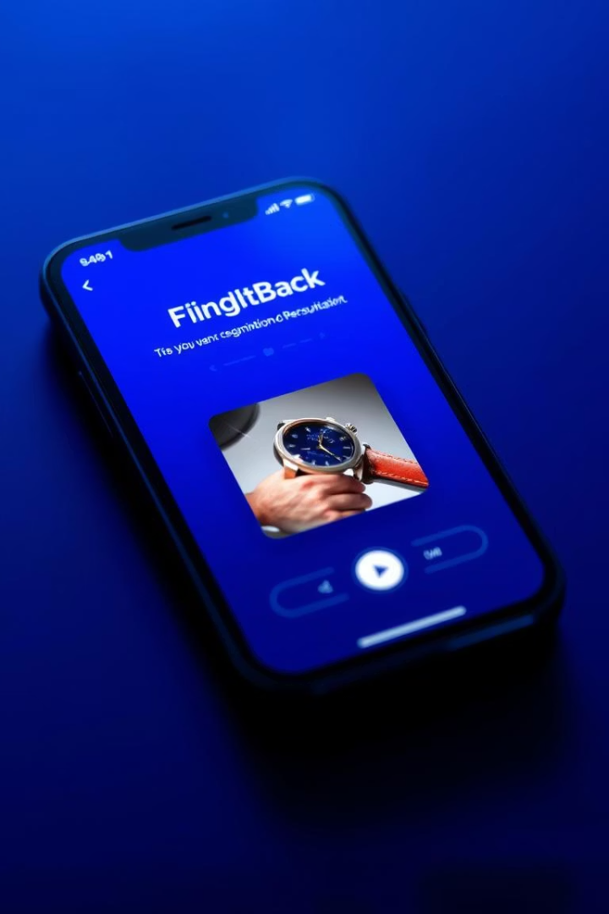




Key Features: Streamlining Recovery
FindItBack is packed with features designed to simplify the lost and found process and enhance the user experience. From smart matching to robust error handling, FindItBack is a comprehensive solution for college campuses.
Upload Items
Smart Matching
Item Gallery
Easily upload photos, locations, dates, and contact information for lost or found items.
Image recognition technology provides intelligent matching of items based on visual similarity.
Browse all posted items in a user-friendly gallery, making it easy to identify potential matches.
Error Handling
Robust error handling ensures smooth operation and a seamless user experience.

Slide 5



Technology Stack: Powering FindItBack
FindItBack leverages a modern technology stack to deliver efficient and accurate results. Each component is carefully selected to ensure optimal performance and scalability.
1
Streamlit
2
TensorFlow
3
Scikit-learn
Our choice of Streamlit allows for rapid UI development, while TensorFlow (MobileNetV2) provides powerful image recognition capabilities. Cosine similarity via scikit-learn ensures accurate matching, and Python uuid generates unique IDs for each item.

Slide 6





Working Pipeline: From Upload to Match
The FindItBack system follows a clear and efficient pipeline, ensuring fast and accurate matching of lost and found items. From the initial upload to the final display of matches, each step is optimized for performance.
Upload
User uploads image and item details.
Process
Image is saved, and metadata is stored in JSON format.
Extract
Features are extracted using MobileNetV2.
Match
Cosine similarity compares features to find top matches.
Display
Top matches are displayed to the user.

Slide 7

Results & Evaluation: Successful Recovery
Our testing demonstrates that FindItBack accurately matches visually similar items, facilitating real contact-based recovery. The user experience is excellent on both desktop and mobile devices.

Slide 8

Conclusion & Future Scope
FindItBack offers a simple, scalable AI solution to a common problem. With potential for future enhancements and easy deployment on campus servers, FindItBack encourages a more responsible and connected student community.
QR Lookup
Email Alerts
Implement QR codes for quick and easy item identification.
Notify users when a potential match is found.
Admin Panel
Provide administrative oversight and management capabilities.
Thank you for your time. We believe FindItBack has the potential to transform the lost and found experience on college campuses and beyond. We look forward to your feedback and support.

